Slide 1

Lane Assist & Object Avoidance System in Urban Setting for Autonomous Vehicles
AuE 8930: Computing and Simulation for Autonomy, Fall 2021
Instructor: Prof. Bing Li
Presented by: Priyanshu & Koundinya

Slide 2
Introduction
Goal -
Simulation showing successful lane keeping and object avoidance in different scenarios (eg:pedestrian blocking the way or slow car blocking the way).
Tools -
Operating System: MS Windows (64-bit)
Simulator: CARLA (Focus is on an urban setting)
Programming Language: Python

Slide 3
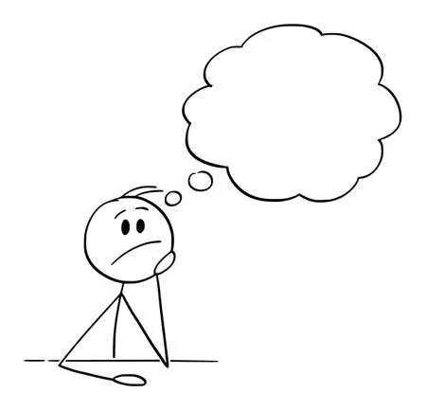
Motivation .. ??

Slide 4
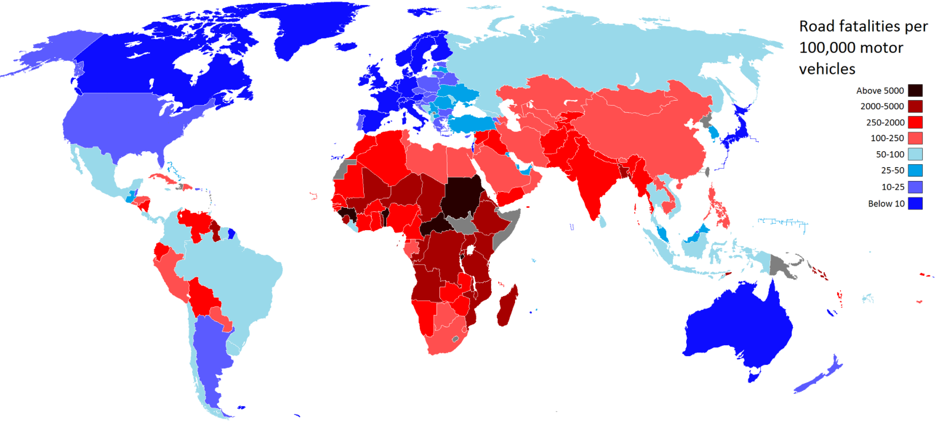
Motivation
Leniency in traffic rules.
Jaywalking pedestrian traffic.
Stray animals on road.
Source: https://www.grsproadsafety.org/programmes/bloomberg-initiative-global-road-safety-2/

Slide 5
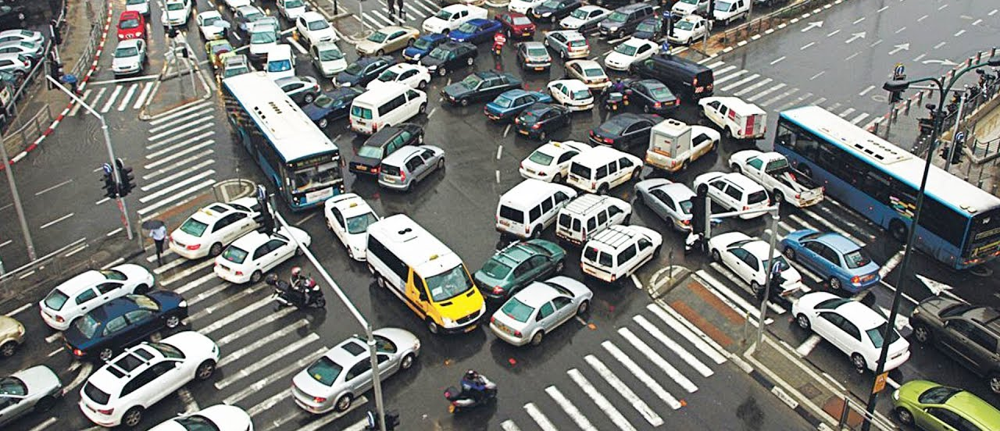
Motivation
How to reduce traffic congestion?
#1 cause of road accidents for people (15-29) is road congestion.
Source: https://www.youtube.com/watch?v=M9S-NtkLPkA

Slide 6
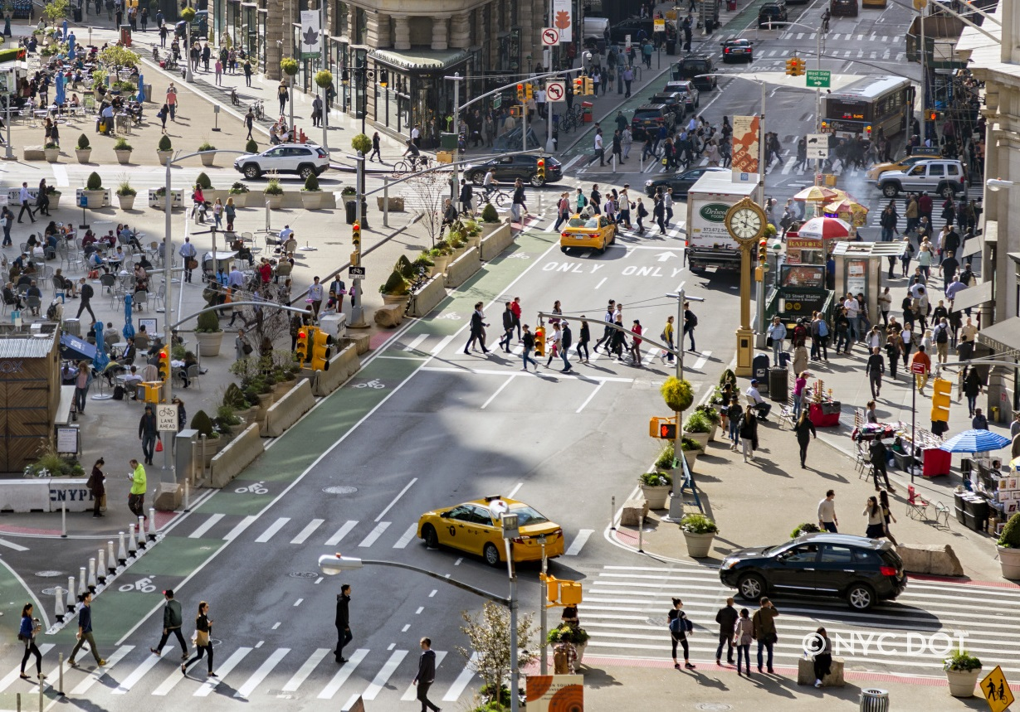
Motivation
How to minimize injuries to pedestrians and stray animals on road?
1/2 of the total road traffic deaths occur among pedestrians.
Source: https://www1.nyc.gov/html/dot/html/about/current-projects.shtml

Slide 7
Part 1
Setting up the CARLA Environment

Slide 8
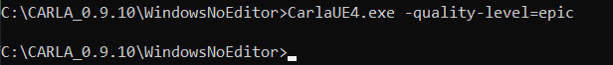
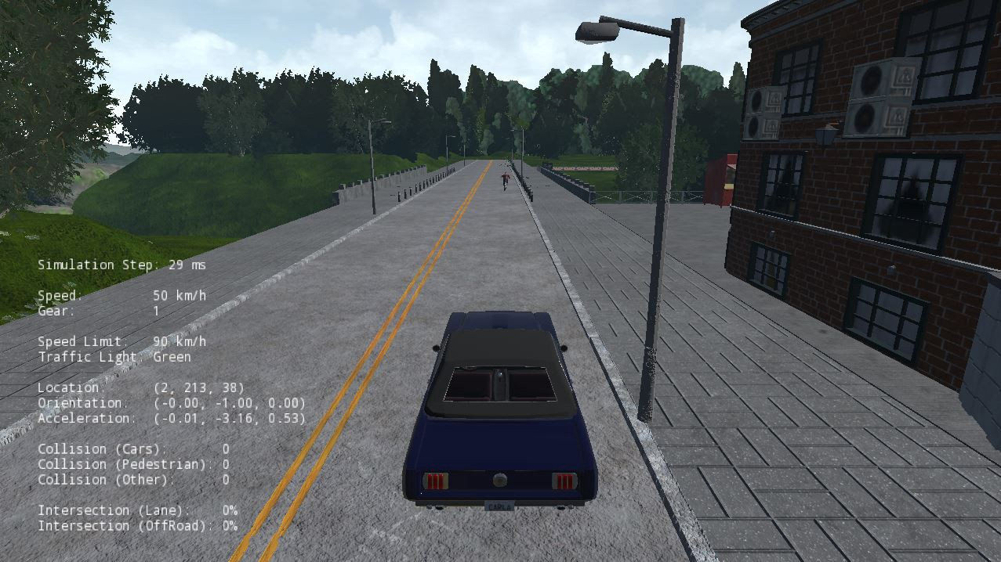
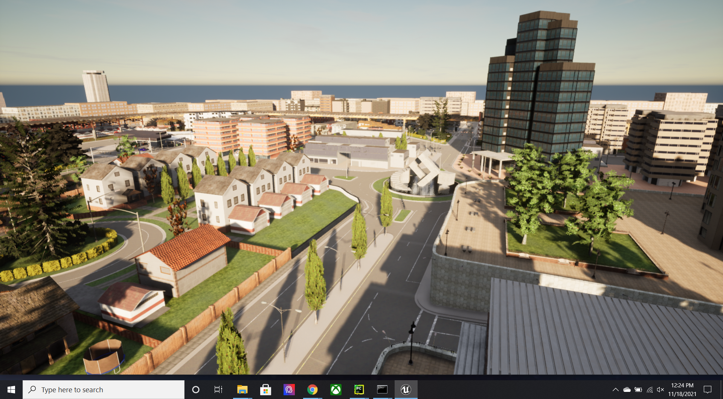
Installing CARLA

Slide 9
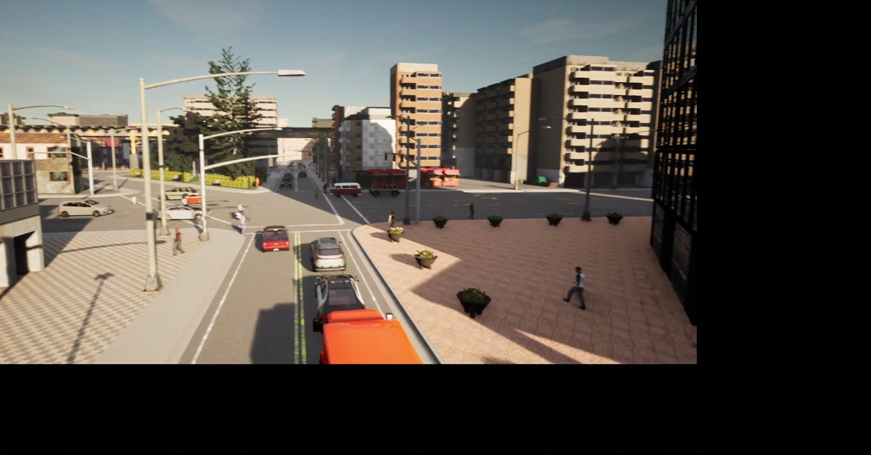
Setting Up CARLA Environment
With a motivation to depict traffic congestion caused by pedestrians and vehicles, we created the Simulation Environment.

Slide 10
Part 2
Lane Keeping using CARLA

Slide 11
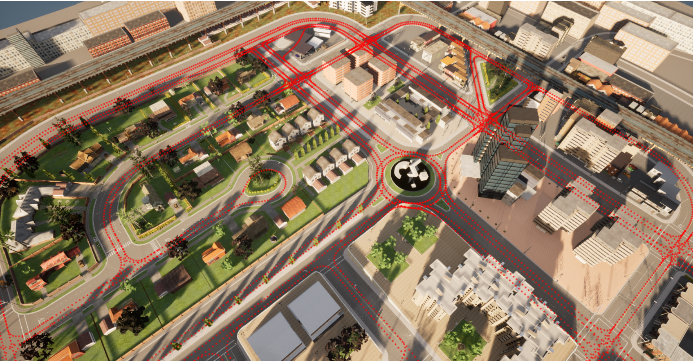
Defining Waypoint
Waypoint in CARLA is a 3D-directed point corresponding to a driving lane.
The variables road_id, section_id, lane_id correspond to a driving road. The id of the waypoint is constructed using these four values.
Waypoints closer than 2cm within the same road share the same id.

Slide 12
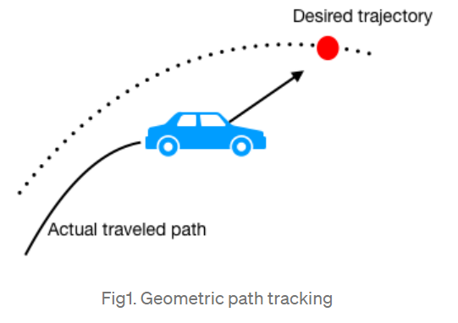
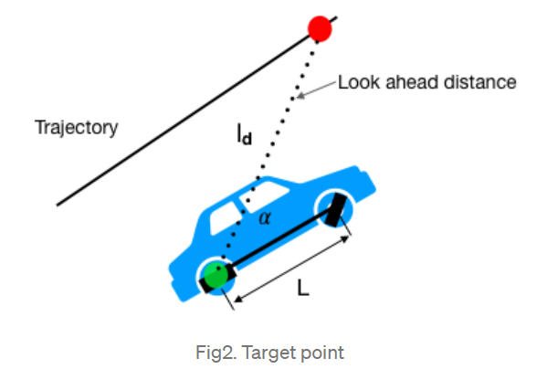
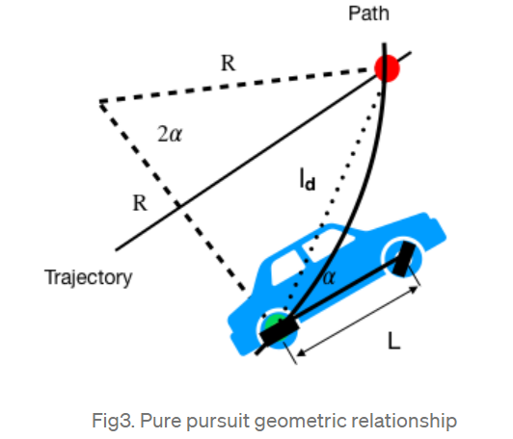
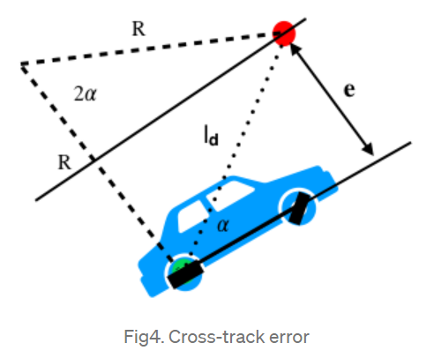
Controller for Lateral Control (Steering)
Pure Pursuit vs Stanley vs PID
Pure Pursuit Controller -
Source: https://dingyan89.medium.com/three-methods-of-vehicle-lateral-control-pure-pursuit-stanley-and-mpc-db8cc1d32081

Slide 13
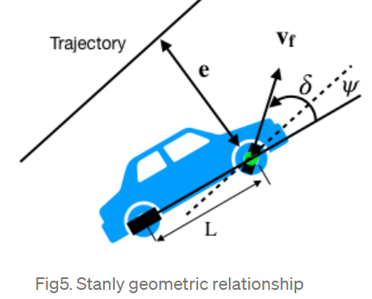
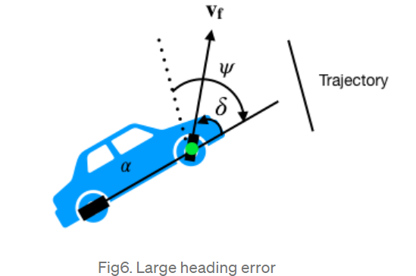
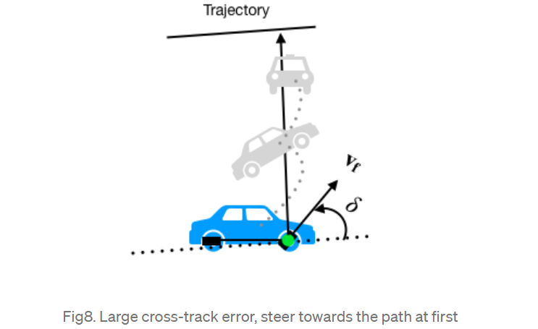
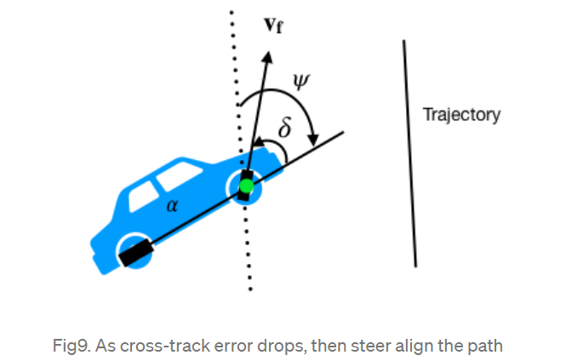
Controller for Lateral Control (Steering)
Pure Pursuit vs Stanley vs PID
Stanley Controller -
Source: https://dingyan89.medium.com/three-methods-of-vehicle-lateral-control-pure-pursuit-stanley-and-mpc-db8cc1d32081

Slide 14
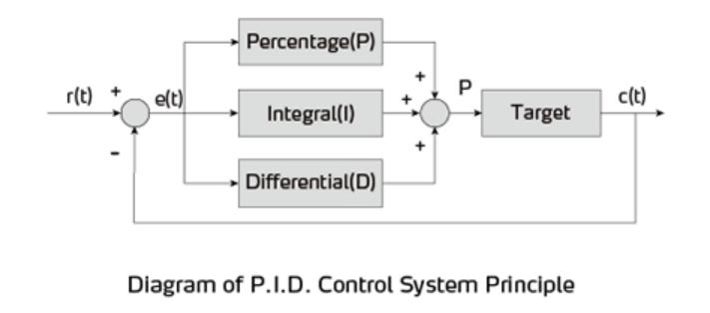
Controller for Lateral Control (Steering)
Pure Pursuit vs Stanley vs PID
PID Controller -

Slide 15
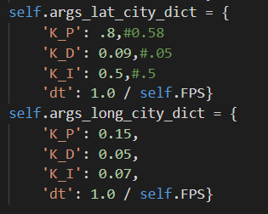
Tuning PID Parameters
Defining Kp, Kd, Ki
Iterative Process

Slide 16
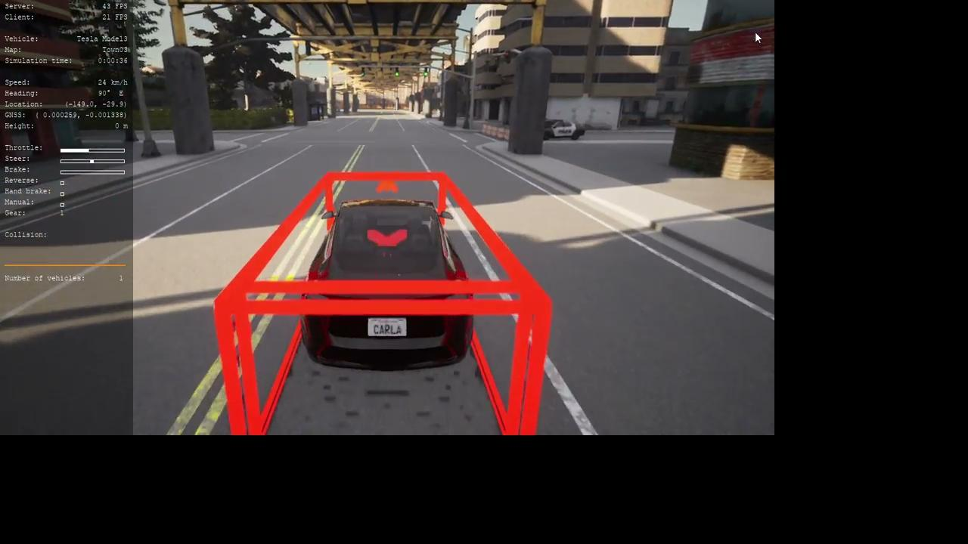
Here’s the demo run for lane keeping!

Slide 17
Part 3
Vehicle Following

Slide 18
Vehicle Following
If there’s a vehicle ahead, our vehicle should maintain a safe distance while following the car in front.
Vehicle follows road speed limit till it is less than 10m away from a vehicle in front.
Once it crosses 10m, it will try to match the speed of the other vehicle.
If it gets closer than the braking distance, vehicle will do an emergency stop.
Otherwise, it considers time to collision to match speeds with the other vehicle.

Slide 19
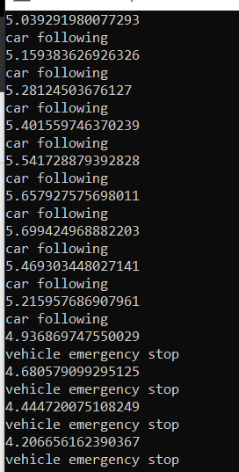
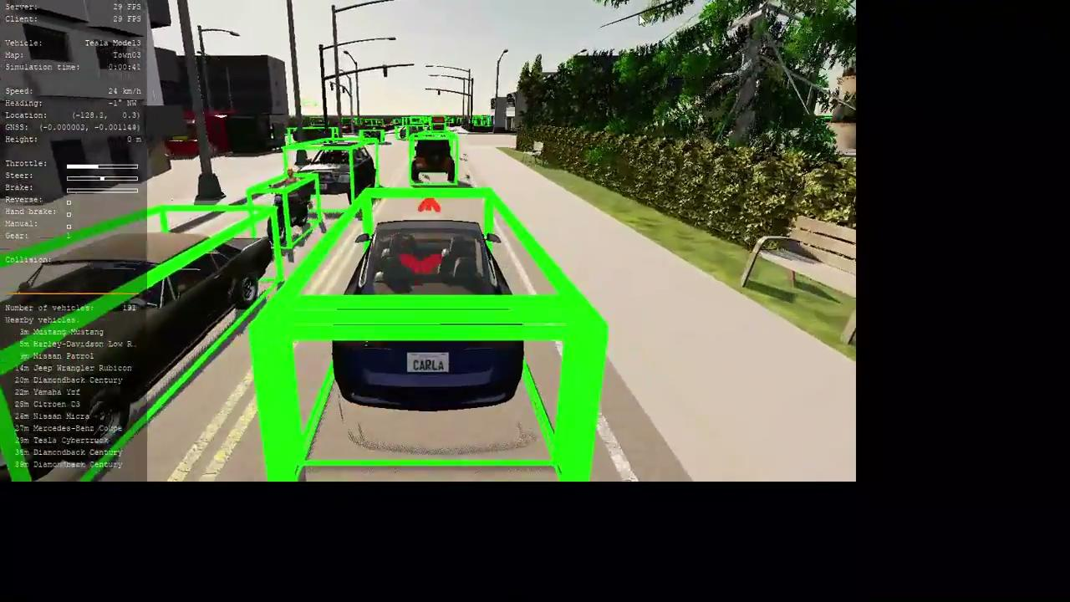
Here’s the demo run for vehicle following!

Slide 20
Part 4
Object Avoidance using CARLA

Slide 21
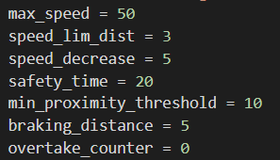
Emergency Braking
If there’s a obstacle ahead; the vehicle should stop at a safe defined distance.
Triggered when distance is less than 5m.
Emergency braking function bypasses the PID controller to slam the brakes and stop.

Slide 22
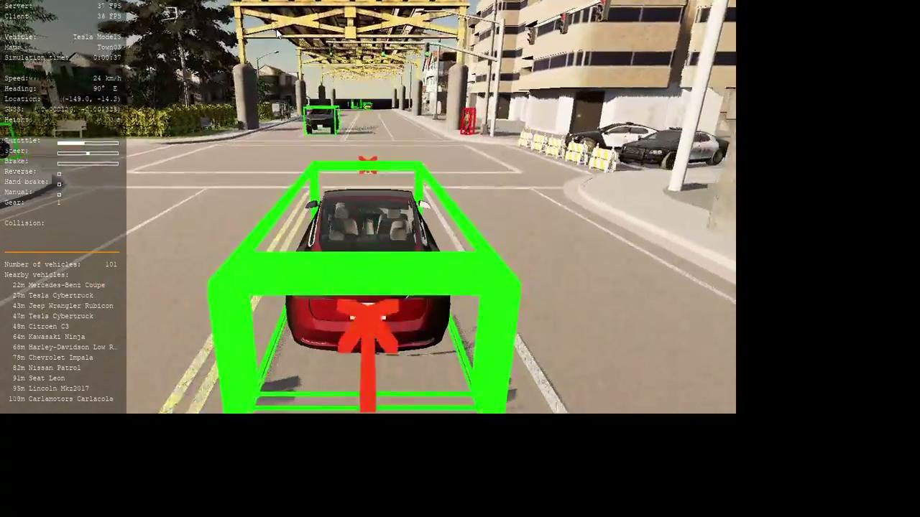
Emergency Braking (Vehicle in front)
Here’s a demonstration of emergency braking involving vehicle -

Slide 23
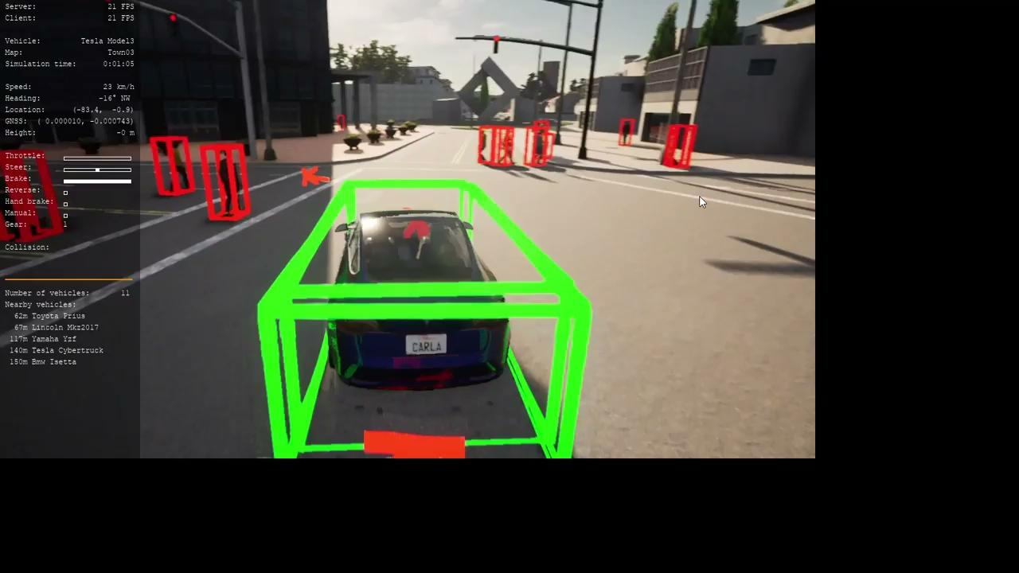
Emergency Braking (Pedestrian in front)
Here’s a demonstration of emergency braking involving pedestrians -

Slide 24
Challenges (in real-world!)
In actual scenarios of traffic congestion; response time is very very less.
The algorithm should be fast enough and the hardware should be powerful enough to process the information as quickly as possible.

Slide 25
Learnings
We’ve understood the functionality of CARLA to some extent and importance of simulators in developing ADAS systems.
We gained a deeper understanding of types of controllers.
Tuning parameters in the simulator is far more time-saving than in the real world.
As an example, for our recent project in Automotive Electronics, we had to tune the PID every time before testing our RC car again on the track in real-time. If the combination doesn’t work, we will have to start again.

Slide 26
THANK YOU,
Dr. Li and fellow classmates

